Slide 1
Linear Regression

Slide 2
What is Linear Regression?
You’re probably familiar with plotting line graphs with one X axis and one Y axis. The X variable is called the independent variable and the Y variable is called the dependent variable.
Simple linear regression plots one independent variable X against one dependent variable Y. Technically, in regression analysis, the independent variable is usually called the predictor variable and the dependent variable is called the criterion variable. However, many people just call them the independent and dependent variables. More advanced regression techniques (like multiple regression) use multiple independent variables.
Regression analysis can result in linear or nonlinear graphs. A linear regression is where the relationships between your variables can be described with a straight line. Non-linear regressions produce curved lines.
Regression analysis is almost always performed by a computer program, as the equations are extremely time-consuming to perform by hand.

Slide 3
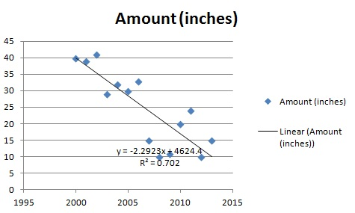
Sample

Slide 4

Linear Regression Equation
Regression analysis is used to find equations that fit data. Once we have the regression equation, we can use the model to make predictions.
If you recall from elementary algebra, the equation for a line is y = mx + b.
In statistics Linear regression is denote by y = a + bx (or) y = b0 + b1x where Y is the dependent variable (that’s the variable that goes on the Y axis), X is the independent variable (i.e. it is plotted on the X axis), b is the slope of the line and a is the y-intercept.
These coefficients a and b are derived based on minimizing the sum of squared difference of distance between data points and regression line.

Slide 5
Find linear regression equation?
SUBJECT | AGE X | GLUCOSE LEVEL Y
1 | 43 | 99
2 | 21 | 65
3 | 25 | 79
4 | 42 | 75
5 | 57 | 87
6 | 59 | 81
Σ | 247 | 486
Predict glucose level if the age of person if 52, 95, and 2?

Slide 6
Co efficient of determination
In statistics, the coefficient of determination, denoted by R2 or r2 and pronounced "R squared", is a number that indicates the proportion of the variance in the dependent variable that is predictable from the independent variable(s).

Slide 7
Multiple Linear Regression
Multiple linear regression is the most common form of linear regression analysis.
Multiple linear regression is used to explain the relationship between one continuous dependent variable from two or more independent variables.
The independent variables can be continuous or categorical (dummy coded as appropriate)
Independent variables should not be multi-collinear
y = b0 + b1X1 + b2X2 + b3X3 + ……….. + bnXn

Slide 8



Evaluation of algorithm
The final step is to evaluate the performance of algorithm. This step is particularly important to compare how well different algorithms perform on a particular dataset. For regression algorithms, three evaluation metrics are commonly used:
Mean Absolute Error (MAE) is the mean of the absolute value of the errors. It is calculated as:
Mean Squared Error (MSE) is the mean of the squared errors and is calculated as:
Root Mean Squared Error (RMSE) is the square root of the mean of the squared errors:
Luckily, we don't have to perform these calculations manually. The Scikit-Learn library comes with pre-built functions that can be used to find out these values for us.

Slide 9
Assumption of Linear Regression
There must be linear relationship between independent and dependent variables
No Autocorrelation
No Multi collinearity
Variance across the independent variable should be same - Homoscedacity
Data should be distributed normally

